Slide 1
Automated-Podcast-Transcription-and-Topic-Segmentation
Subtitle:-AI-Based Analysis of “The Adventures of Sherlock Holmes”
Presented by:-Sourajit Muduli

Slide 2
Introduction:-
The Context: Audiobooks are a rapidly growing medium for storytelling and education.
The Problem: Unlike text, audiobooks are "unsearchable." Listeners cannot easily find specific scenes, quotes, or character interactions without scrubbing through hours of audio.
The Solution: An automated system that "listens" to the story, transcribes it, and segments it by narrative context.

Slide 3
Project Objectives:-
Primary Goal: To create a searchable, structured index for long-form narrative audio.
Key Objectives:
Automated Transcription: Convert classic literature audio to text.
Narrative Segmentation: Detect scene shifts (e.g., moving from "221B Baker Street" to a crime scene).
Sentiment Tracking: Visualize the "Narrative Arc" (Tension/Mystery vs. Calm).
Keyword Extraction: Identify key characters (Holmes, Watson) and clues.

Slide 4
The Dataset-:
Name: adventures_sherlock_holmes_rg_librivox
Source: LibriSpeech
Description:
High-quality, read speech from Arthur Conan Doyle’s The Adventures of Sherlock Holmes.
Why this dataset? It provides a challenging, lengthy narrative structure perfect for testing segmentation algorithms (unlike short voice commands).

Slide 5
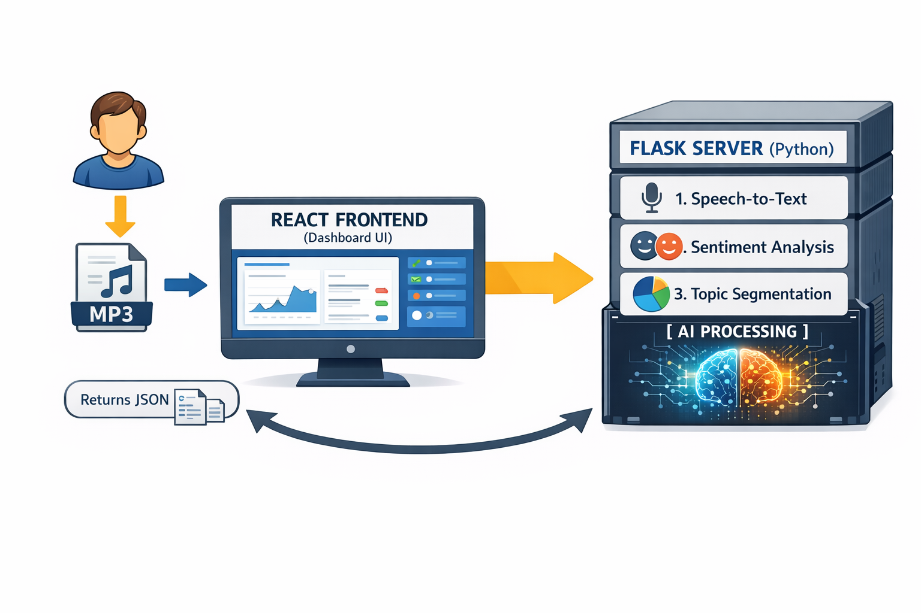
System Architecture :-
Input: MP3 Chapter File.
Processing:
ASR (Speech-to-Text): Google SpeechRecognition API.
NLP Engine: TextBlob (Sentiment) + NLTK (Tokenization).
Segmentation: Context-based splitting.
Output: JSON Data → React Dashboard.

Slide 6
Key Features:-
Interactive Dashboard:
Drag & Drop Upload: Easy interface for loading audiobook chapters.
Smart Audio Player: Syncs audio with the transcript text.
Sentiment Graph: A visual line graph showing the rising and falling tension of the story.
Keyword Cloud: Instantly highlights important terms (e.g.“Holmes", “Sherlok").

Slide 7
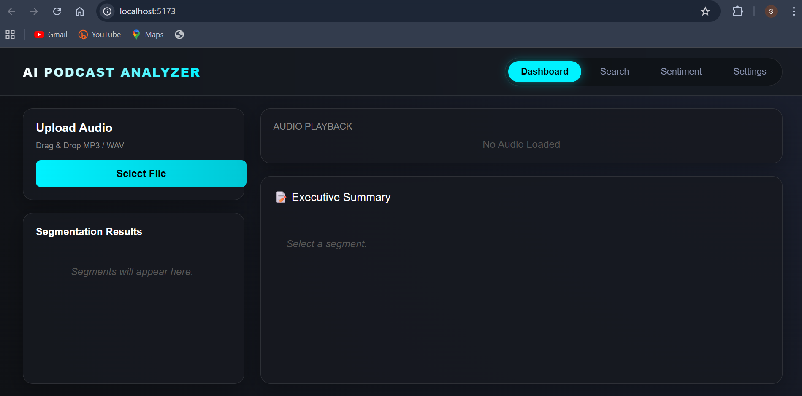

Slide 8
Technical Stack :-
Frontend: React.js, Vite, Tailwind CSS (Modern Dark/Cyberpunk UI)
.
Backend: Python, Flask (REST API).
AI Libraries:
SpeechRecognition (Transcription)
ScTextBlob (Sentiment Analysis)
Testing: Python unittest framework.

Slide 9
Challenges Faced :-
Narrative Complexity: Unlike news or podcasts, stories have subtle topic shifts that are harder for AI to detect.
Vocabulary: 19th-century English (e.g., "hansom cab," "gasogene") requires robust transcription models.
File Size: Processing 30-minute audiobook chapters required optimizing the backend to prevent timeouts.

Slide 10
Testing & Validation :-
Methodology:
Implemented Modular Unit Testing for the API.
Verified transcription accuracy against known Sherlock Holmes texts.
Results:
✅ Successfully handles long-form MP3 uploads.
✅ Correctly rejects non-audio files (Security).
✅ Sentiment graphs accurately reflect plot climaxes.

Slide 11
Future Scope :-
Character Diarization: Distinguishing between the Narrator, Holmes, and Watson (Speaker A vs. Speaker B).
Multi-Book Support: Scaling the database to handle entire libraries.
Voice Search: Asking the app questions like "Where did Holmes find the ring?" and getting an audio timestamp.

Slide 12
Conclusion :-
Summary:
Developed a Full-Stack application for analyzing audiobooks.
Successfully applied AI/NLP to classic literature.
Demonstrated professional software practices (Git, Documentation, Testing).
Final Thought: "Unlocking the data inside stories to make literature more accessible."

Slide 13
Thank You!

